Slide 1
AVR Interfacing Interrupt

Slide 2
Agenda
Interrupts Definition
AVR Interrupts
AVR External Interrupts
AVR External Interrupts Programming

Slide 3
Interrupts Definition
An interrupt is a signal to the processor emitted by hardware or software indicating an event that needs immediate attention.
When an interrupt event occurs, the microcontroller pause its current task and attend to the interrupt by executing an Interrupt Service Routine (ISR) at the end of the ISR the microcontroller returns to the task it had pause and continue its normal operations.
Interrupt Service Routine (ISR) or Interrupt Handler
Piece of code that should be execute when an interrupt is triggered.
Each interrupt has its own ISR. Its address in ROM is save in interrupt vector table.
It should be deterministic and short as possible so not to pause the CPU much of time.

Slide 4
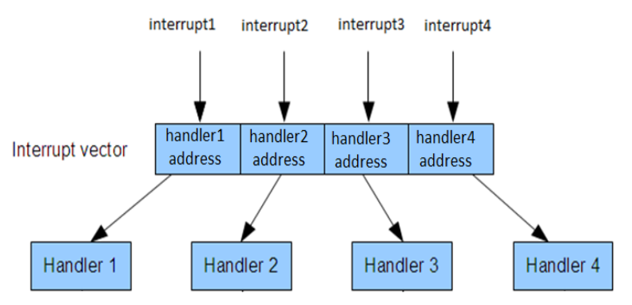
Interrupts Definition
Interrupt Vector Table(IVT)
Constant table in Flash EEPROM Program memory.
Each interrupt has specific address in the interrupt vector table for its ISR.
Handler = ISR = Code

Slide 5
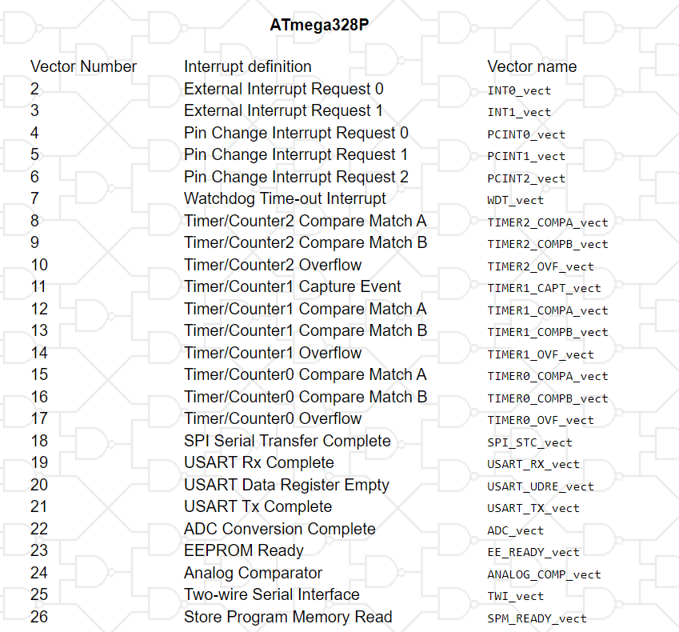
AVR Interrupts
Interrupt Vector Table(IVT) of Atmega328P
The lower the address the higher is the priority level.
All interrupts are assigned individual enable bits to which must be written a logic one together with the Global Interrupt Enable bit

Slide 6
AVR Interrupts
What happens when an interrupt occurs in AVR Microcontrollers?
The microcontroller completes the execution of the current instruction.
Clears the Global interrupt enable bit.
Stores the address of the next instruction that should have been executed (the content of the PC) and all the CPU registers are pushed onto the stack.
The interrupt vector of the triggered interrupt (ISR start address of this interrupt) is then loaded in the PC(program counter) from the interrupt vector table.
Microcontroller starts execution from that point up until reaches the end of the ISR.
The address that was stored on the stack in step 1 is reloaded in the PC register.
The Global interrupt enable is re-enabled.
The micro-controller then continue executing the program.

Slide 7
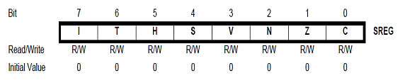

AVR Interrupts
Status Register Contains the status of the flags such as Overflow flag, Negative flag, Zero flag, Carry flag, Half-carry flag, Global Interrupt mask (I) bit.
How to set the I-bit? SREG = SREG | (1<<7);
How to clear the I-bit? SREG = SREG & (~(1<<7));
On Atmega328P microcontroller there are two (2) external interrupts:
External Interrupt 0 (INT0) : Triggered from pin 2 (PD2).
External Interrupt 1 (INT1) : Triggered from pin 3 (PD3).

Slide 8
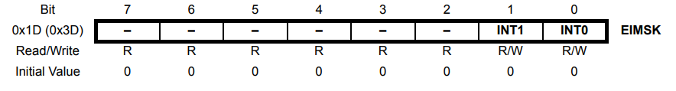
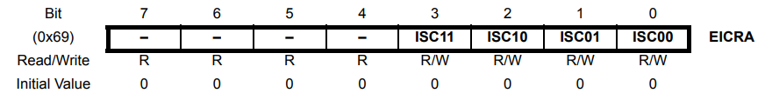
AVR External Interrupts Programming
External Interrupt Mask Register
The ATmega 328P supports two external interrupts which are individually enabled by setting bits INT1 and INT0 in the External Interrupt Mask Register
EICRA – External Interrupt Control Register A The external interrupt control register A contains control bits for interrupt sense control

Slide 9
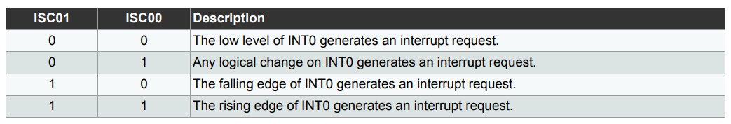
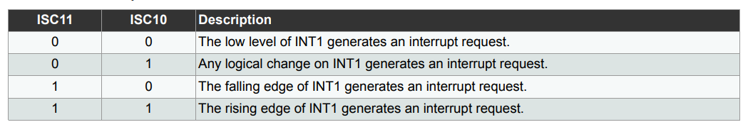

AVR External Interrupts Programming
EICRA – External Interrupt Control Register
INT0 control
INT1 control

Slide 10
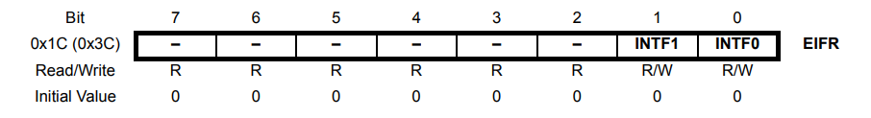
AVR External Interrupts Programming
EIFR – External Interrupt Flag Register
When an edge or logic change on the INT0 pin triggers an interrupt request, INTF0 becomes set (one). If the I-bit in SREG and the INT0 bit in EIMSK are set (one), the MCU will jump to the corresponding Interrupt Vector. The flag is cleared when the interrupt routine is executed.

